Slide 1
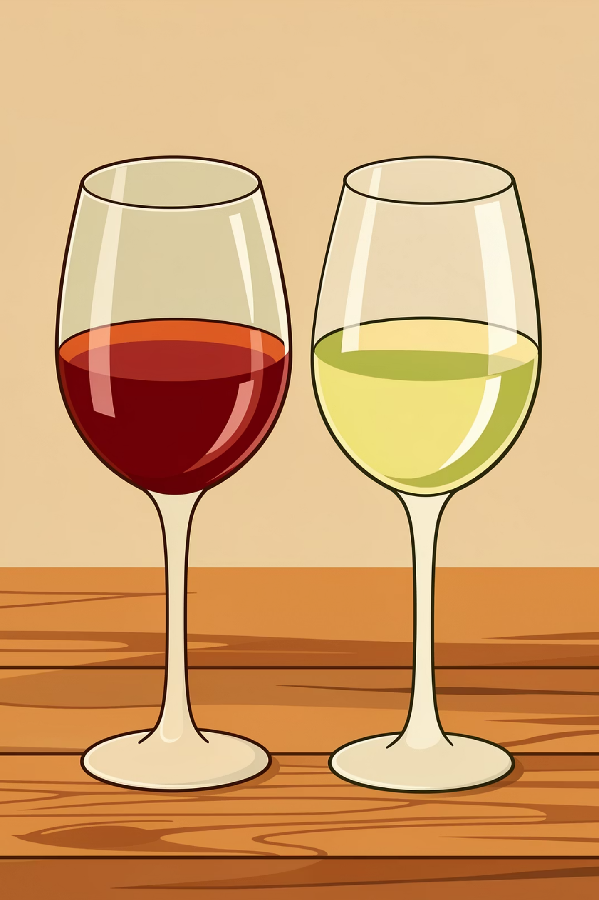
Wine Quality Analysis Project
End-to-end data science case study exploring physicochemical drivers of wine quality across large red and white wine datasets. We identify chemical correlates, segment wines by profile, set benchmarks, and build predictive models from lab measurements.

Slide 2
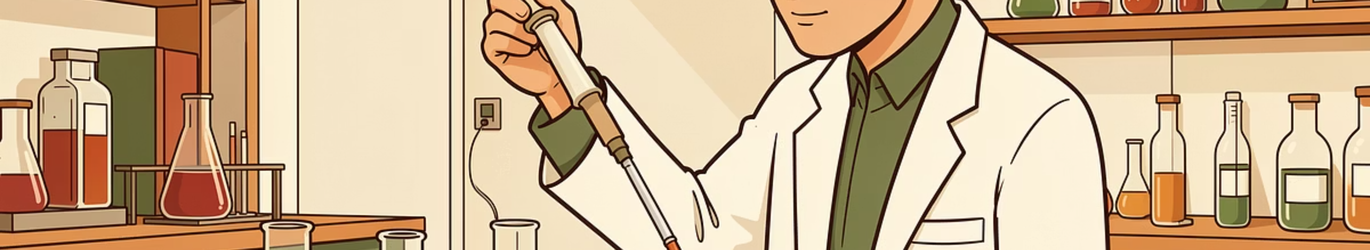
Project Objectives
Analyze
Segment
Uncover chemical features that impact expert and consumer quality ratings.
Cluster wines by chemical profile and relate segments to quality scores.
Benchmark
Define actionable chemical thresholds winemakers can target.

Slide 3

Key Datasets
Datasets from the UCI Machine Learning Repository containing 12 physicochemical features and expert quality ratings for thousands of red and white wines.
Red Wine: winequality-red.csv
White Wine: winequality-white.csv

Slide 4




Core Techniques & Workflow
Data Cleaning & EDA
Correlation & Insights
Dimensionality Reduction
pandas, numpy, seaborn, matplotlib — distributions, missing values, outliers.
Feature relationships analyzed in chemistry context.
PCA to summarize chemistry into interpretable axes.
Clustering
k-Means, silhouette, elbow method to segment wines.

Slide 5


Exploratory Data Analysis (EDA)
Quality Score Distribution
Red Wine
White Wine
~83% score 5–6 (acceptable to good)
Only ~1% reach very high scores (7–9)
~75% score 5–6
4% reach 7–9 (slightly higher than red)

Slide 6

Correlation With Consumer Score Analysis (Spearman)
Spearman correlations reveal monotonic relationships between chemistry and consumer scores — useful for ordinal score interpretation.
Red Wine — Key Correlates
Alcohol & sulphates: positive with consumer score. Volatile acidity, chlorides, total SO₂: negative.
White Wine — Key Correlates
Alcohol & pH: positive. Density, chlorides, total SO₂: strong negatives.
Interpretation ties chemistry to perception: alcohol often signals ripeness and body; volatile acidity and chlorides associate with lower perceived quality.

Slide 7
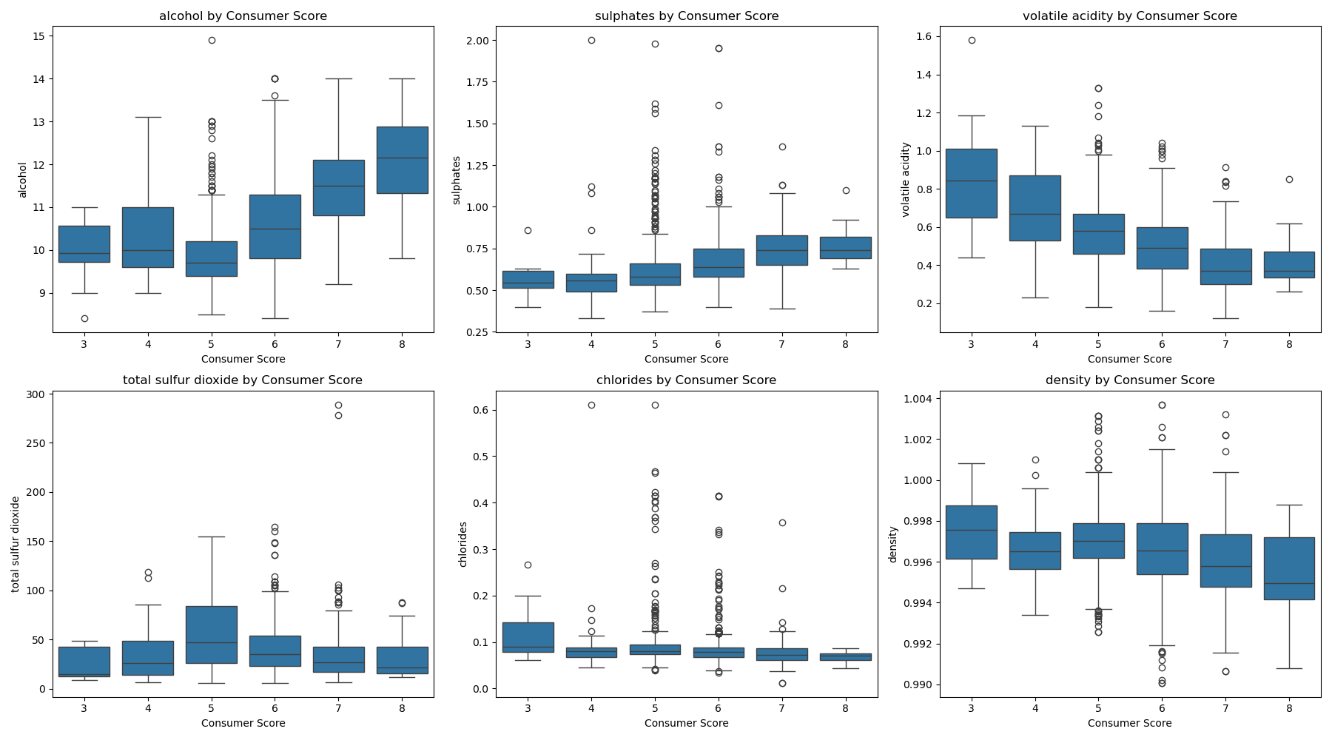
Distributions of Highly Correlated Variables with Consumer Scores
.
Boxplots Red:
Alcohol and sulphates increase with score; volatile acidity, chlorides, density decrease as quality rises.

Slide 8
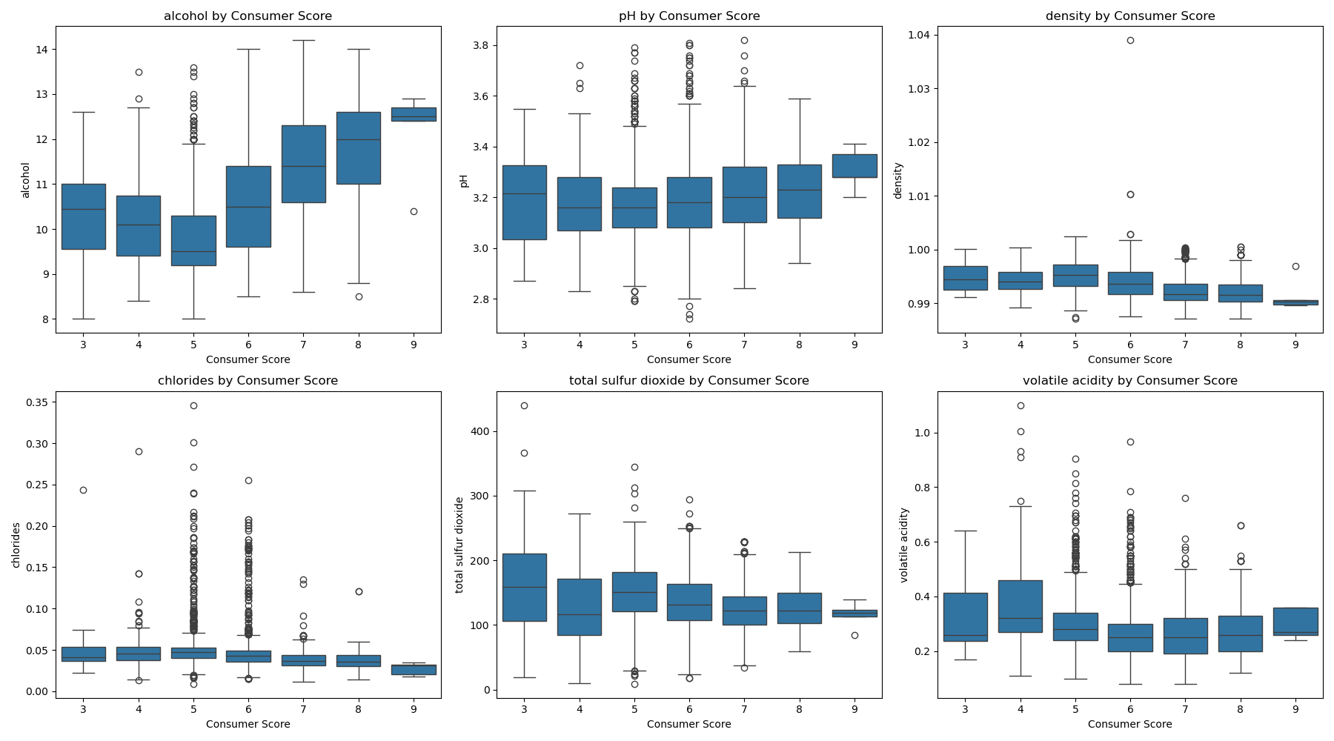
Distributions of Highly Correlated Variables with Consumer Scores
.
Boxplots White:
Alcohol and pH rise with higher scores; density and chlorides peak in low-quality wines.

Slide 9
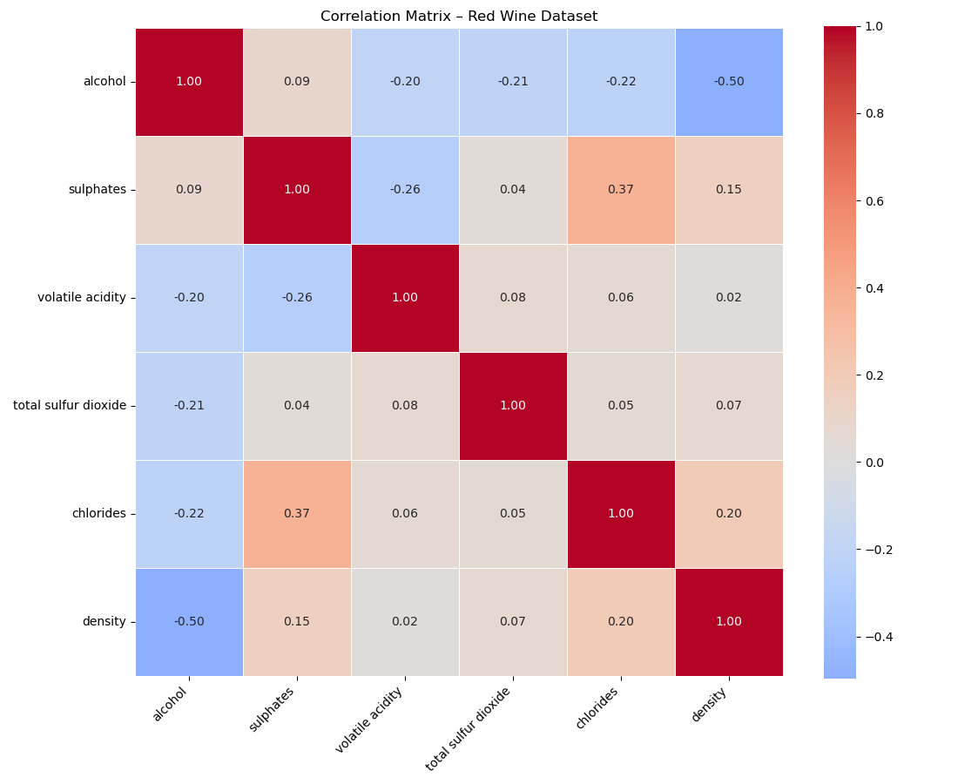
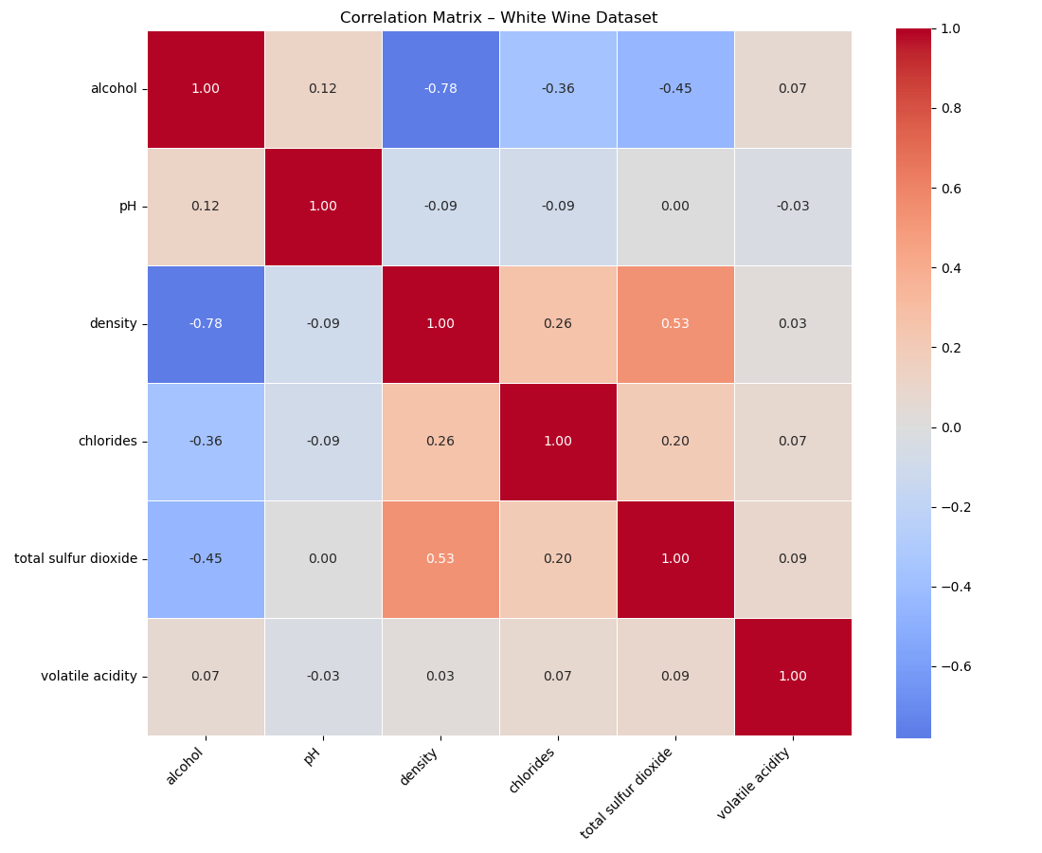
Correlation Between Chemical Variables
Red:
Visualizes Alcohol Negative Relationship with other variables vs density positive relationship with other variables
White:
even negative relationship with alcohol while density positive correlation and pronounced minerals.

Slide 10
Correlation Analysis & Chemical Summary Insights
Variable
Typical Correlation
Explanation (Red & White)
Alcohol
Strong Negative (density)
Ethanol lowers density; proxy for ripeness
Sulphates
Slight Positive (chlorides/density)
Added for stabilization; tracks with mineral ions
Volatile Acidity
Negative (alcohol/sulphates)
Indicates microbial/fermentation stress
Total SO₂
Weak
Reflects winemaker additions more than chemistry
Chlorides
Negative
Reflects soil/mineral/underripeness
pH (White only)
Weak/Complex
Controlled via acidification in white wines
Density
Strong Negative (alcohol)
Alcohol and dissolved solids dominate density in whites

Slide 11
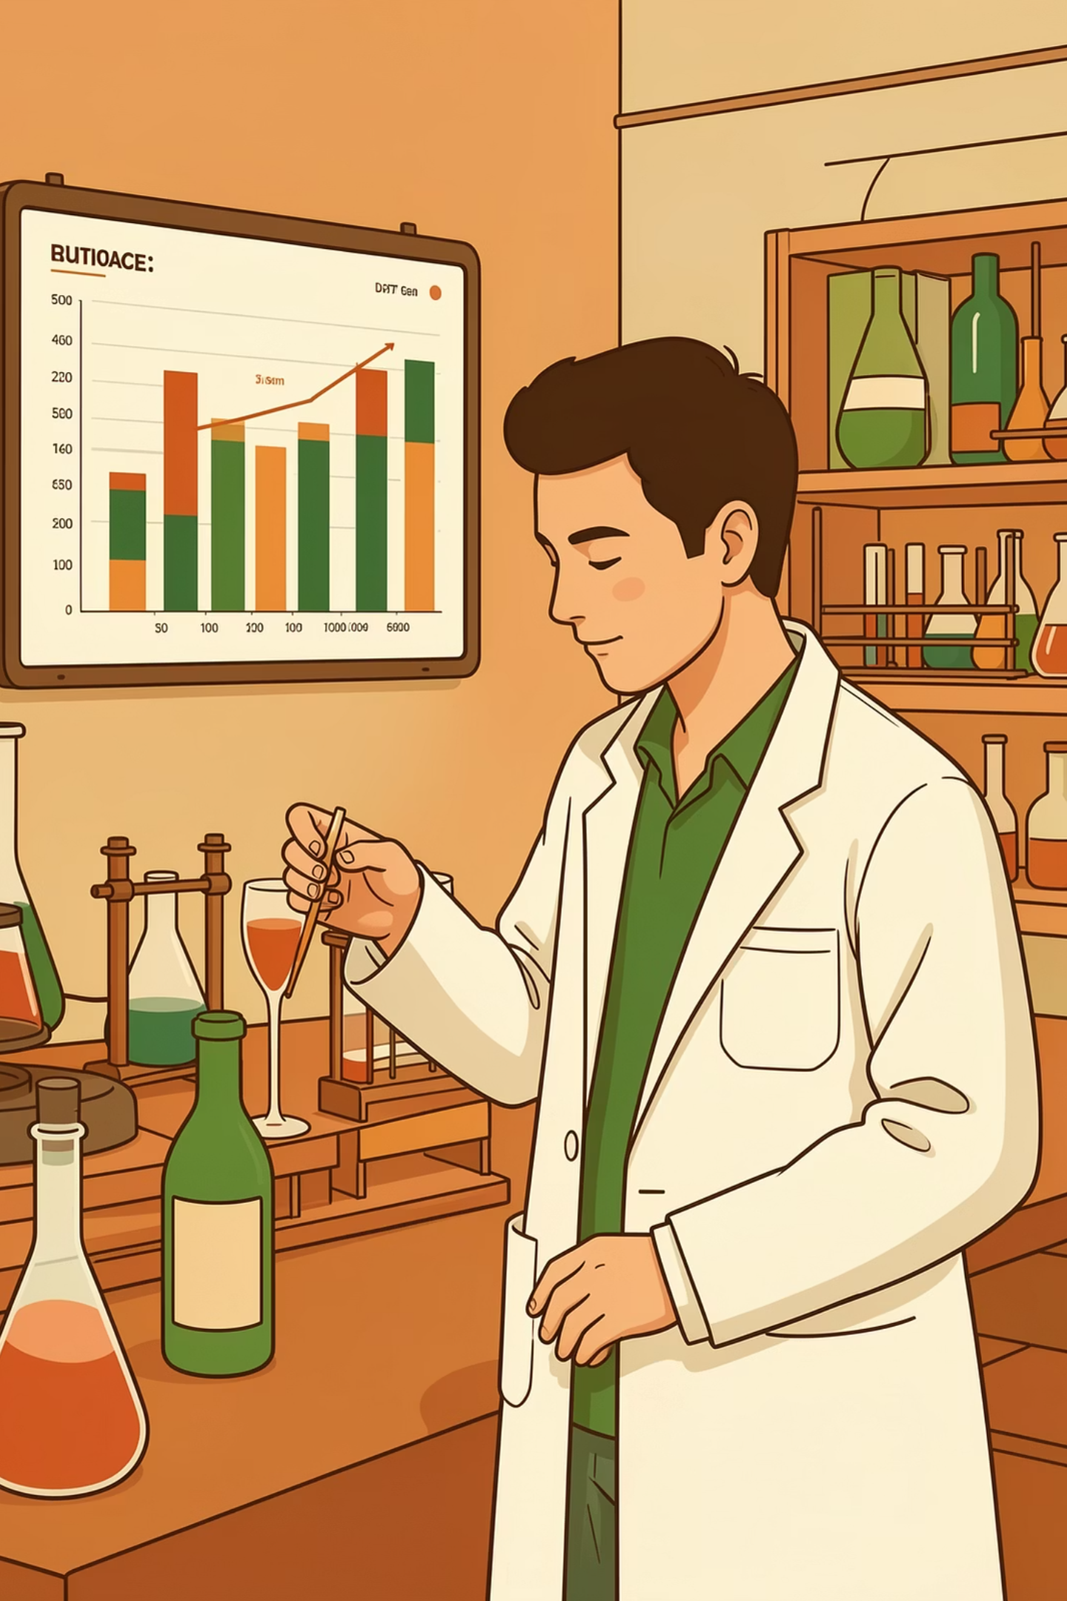
Key Results & Insights
Consumer scores are predictable from chemistry; PCA identifies two main quality axes; clustering reveals practical benchmarks; actionable targets for winemaking defined.

Slide 12
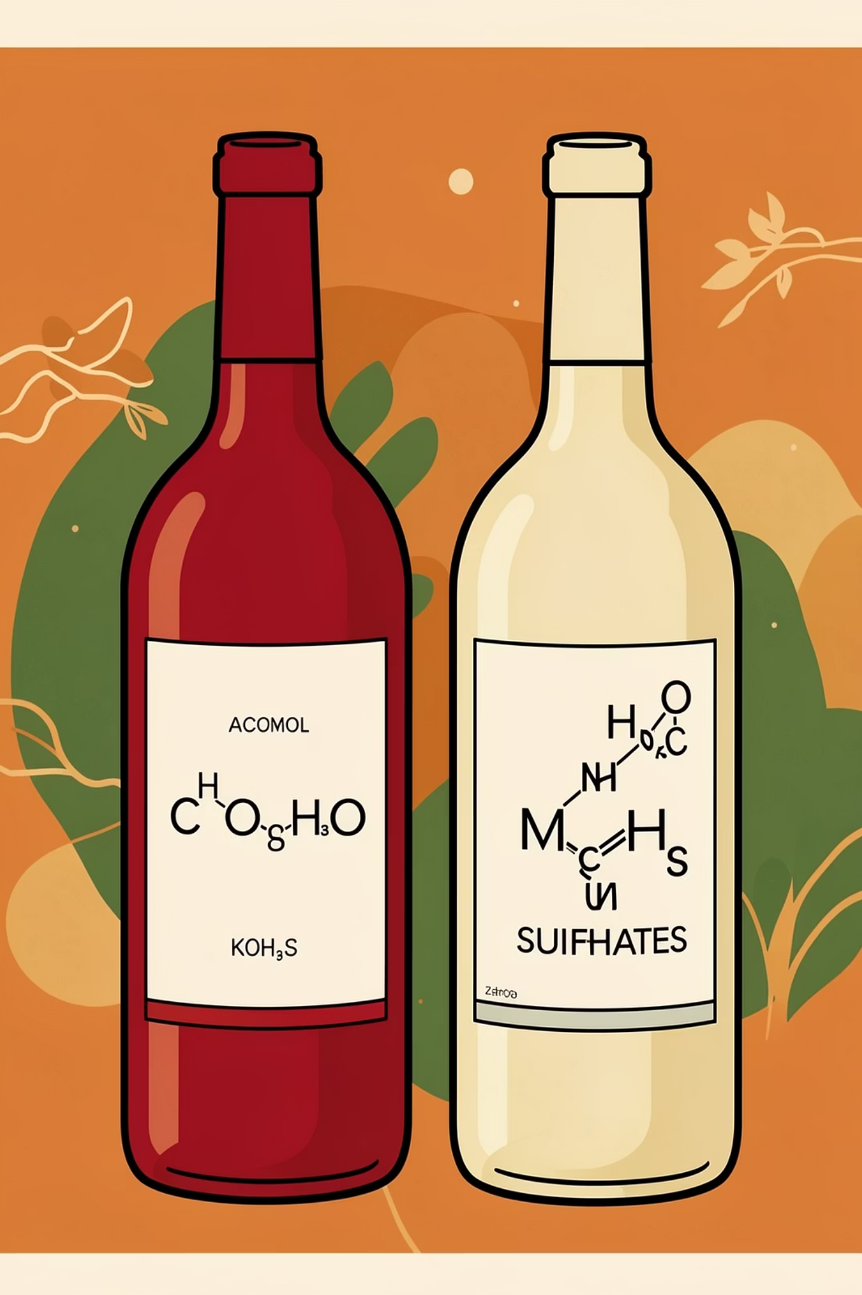
Predictive Features by Wine Type
Red Wine
White Wine
High Alcohol
High Sulphates
Low Volatile Acidity
Low Chlorides
High Citric Acid
High Alcohol
High pH
Low Density
Low Chlorides
Low Total Sulfur Dioxide

Slide 13
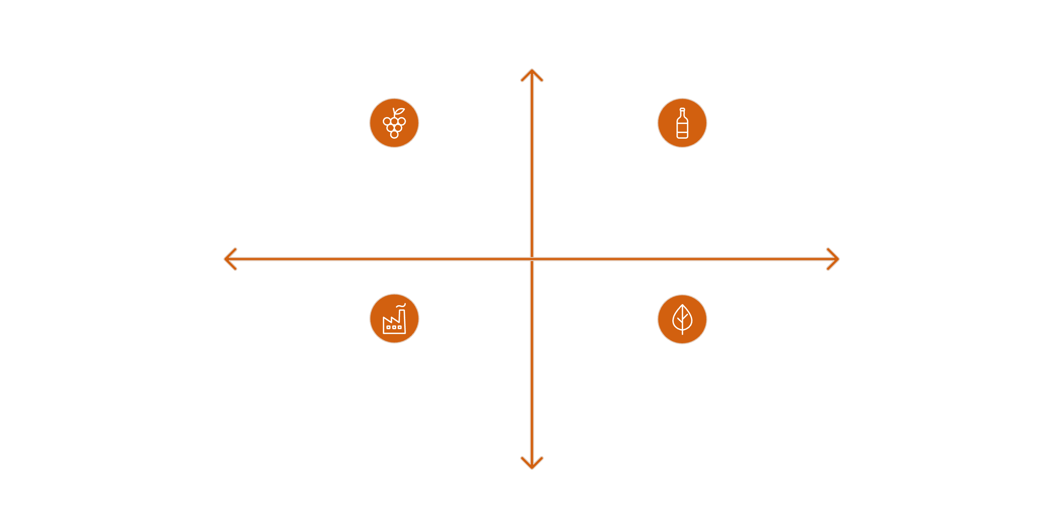




PCA Interpretation
PC1 — Ripeness & Fermentation
PC2 — Processing/Stabilization
High alcohol, low density, high citric acid & sulphates, low volatile acidity → higher quality.
High sulfur dioxide, more residual sugar, higher density → processing/stability axis.
High Ripeness & Fermentation
High Ripeness & Fermentation
High Ripeness + High Processing
Low Processing/Stabilization
High Processing/Stabilization
High Processing/Stabilization
Low Ripeness & Low Processing
Low Ripeness & Fermentation
Wines with high PC1 and low PC2 consistently score higher.

Slide 14
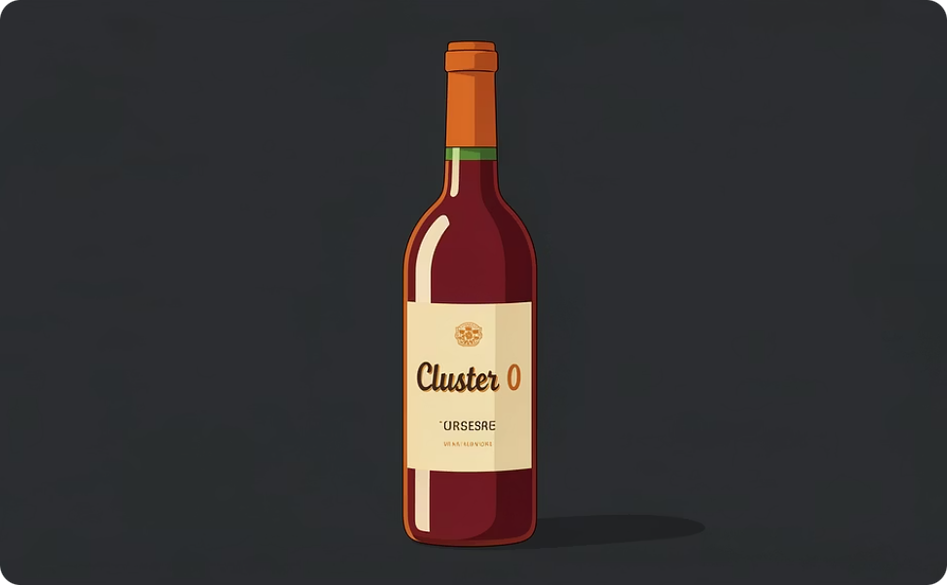
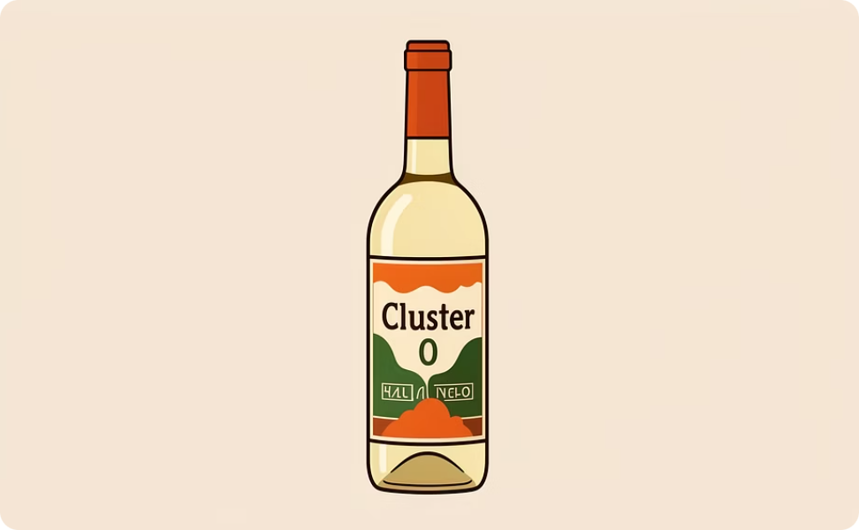
Cluster Benchmarks (Top Clusters)
Red Cluster #0
White Cluster #0
Highest mean score 5.95. Benchmarks: Alcohol > 10.6%, Sulphates > 0.75 g/L, VA < 0.41 g/L, Chlorides < 0.10 g/L.
Highest mean score 6.17. Benchmarks: Alcohol > 11.2%, Sulphates > 0.51 g/L, VA < 0.28 g/L, Chlorides < 0.04 g/L.

Slide 15
Actionable Chemical Targets
Practical thresholds derived from clusters to guide winemaking decisions:
Variable
Red Benchmark
White Benchmark
Alcohol (%)
> 10.6
> 11.2
Sulphates (g/L)
> 0.75
> 0.51
Citric Acid (g/L)
> 0.48
> 0.28
Volatile Acidity (g/L)
< 0.41
< 0.28
Chlorides (g/L)
< 0.10
< 0.04
pH
> 3.18
> 3.31
Density
< 0.9978
< 0.9920
Total SO₂ (mg/L)
< 30
< 123
Residual Sugar (g/L)
< 2.6
< 3.4

Slide 16

Reproducibility, Impact & References
Reproduce the analysis by running Wine_Quality_Analysis.ipynb after installing dependencies (pandas, numpy, matplotlib, seaborn, scikit-learn). Datasets available from UCI.
UCI WINE QUALITY
CORTEZ ET AL., 2009
SCIKIT-LEARN
Why it matters: objective chemistry supports pricing, branding, quality control, and transferable techniques across food and beverage analytics.

